Slide 1
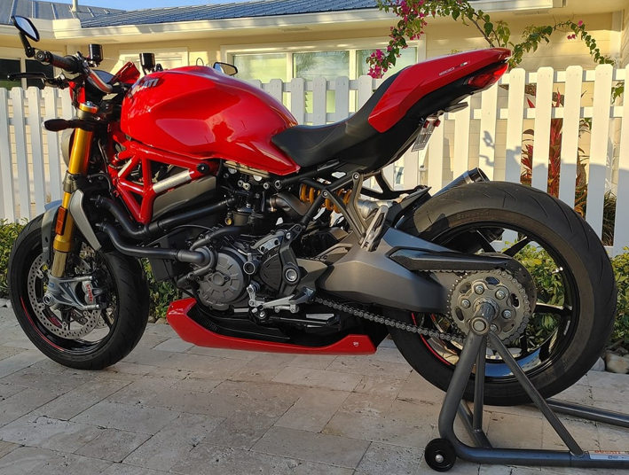
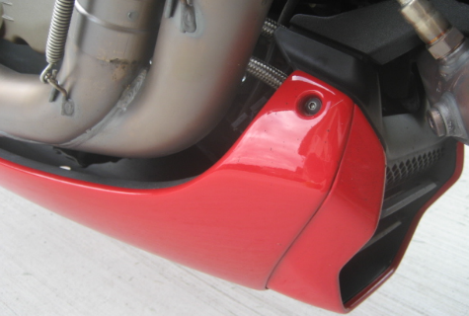
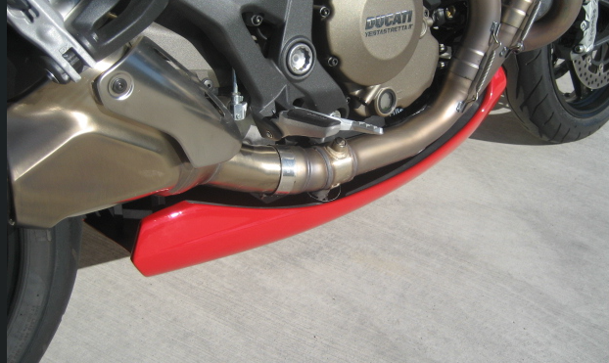
2014-2020 Monster 1200 Custom Bellypans
Professionally designed/manufactured
Hand-laid composite material
Color-matched base coat/clear coat urethane
Heat-resistant material opposite exhaust system
Stainless steel fasteners (hardware included)
Made in USA
Base, S and R models
$529 ready to install

Slide 2
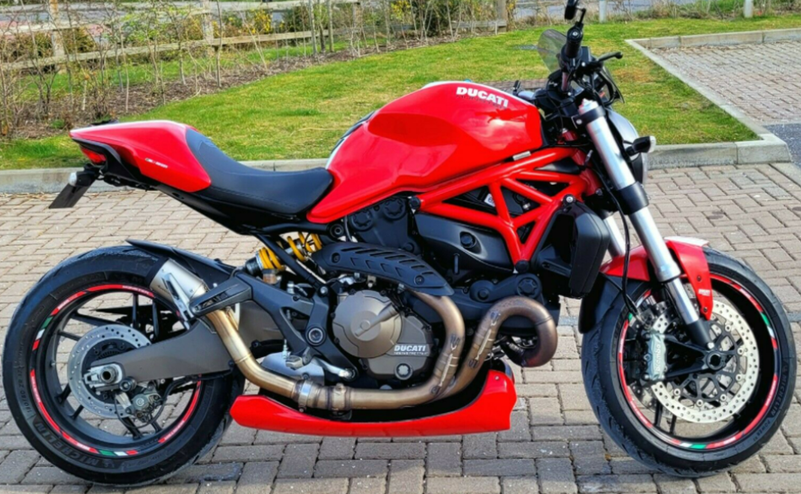
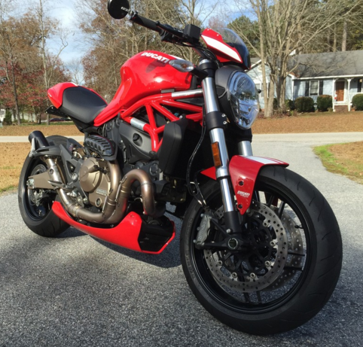
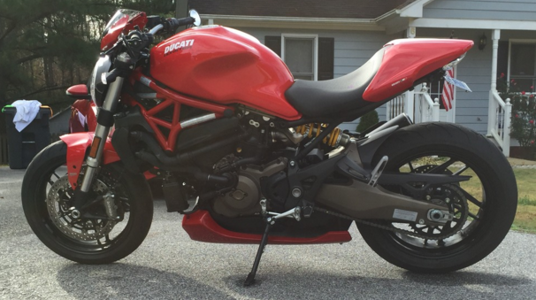
2015-2020 Monster 821 Custom Bellypans
Professionally design/manufactured
Hand-laid composite material
Color-matched base coat/clear coat urethane
Heat-resistant material opposite exhaust system
Stainless steel fasteners (hardware included)
Made in USA
$529 ready to install

